Slide 1
Project Explintion and Conclusion

Slide 2

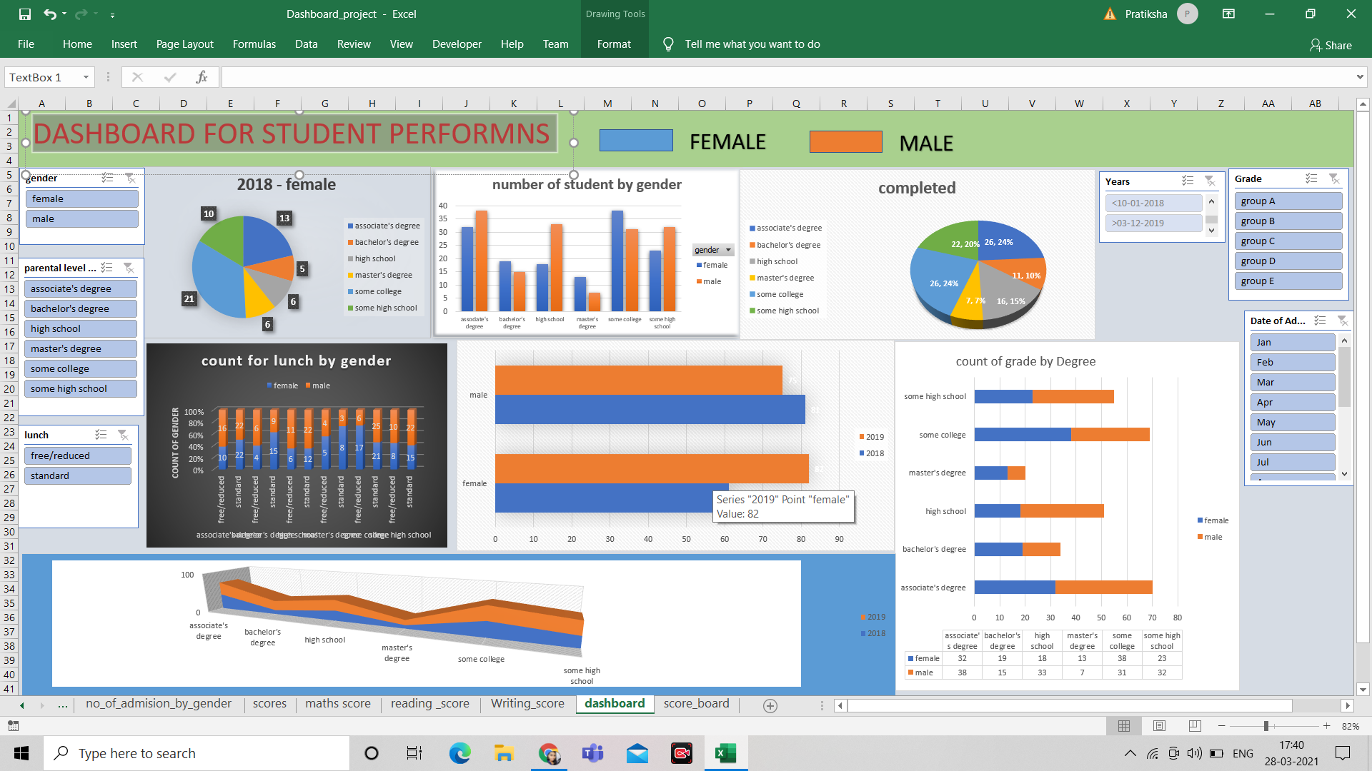
DASHBOARD FOR STUDENT PERFORMNS

Slide 3
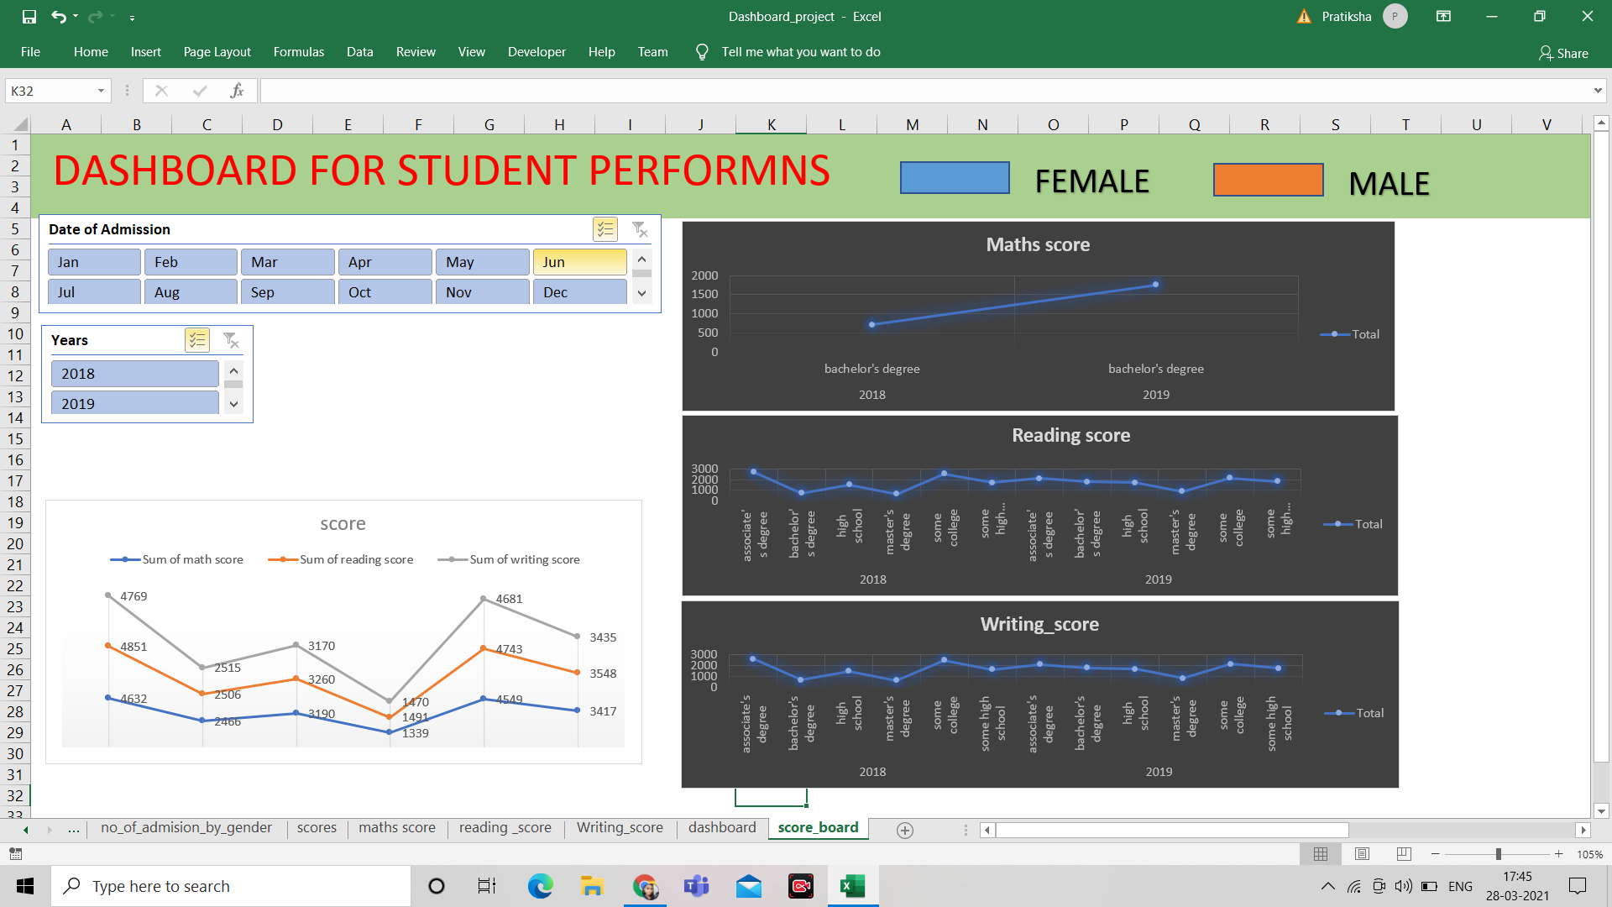
Score board For 2018 and 2019

Slide 4
Project Conclusion
This project is a collection of information of student 2018 and 2019 student in 5 differnt parntal level Degree .i took 300 rows and more than 8 columns of row data.
I did a dashboard which showes me progress of male and femal candidtes how are studing in 2018 or 2019.

